Slide 1
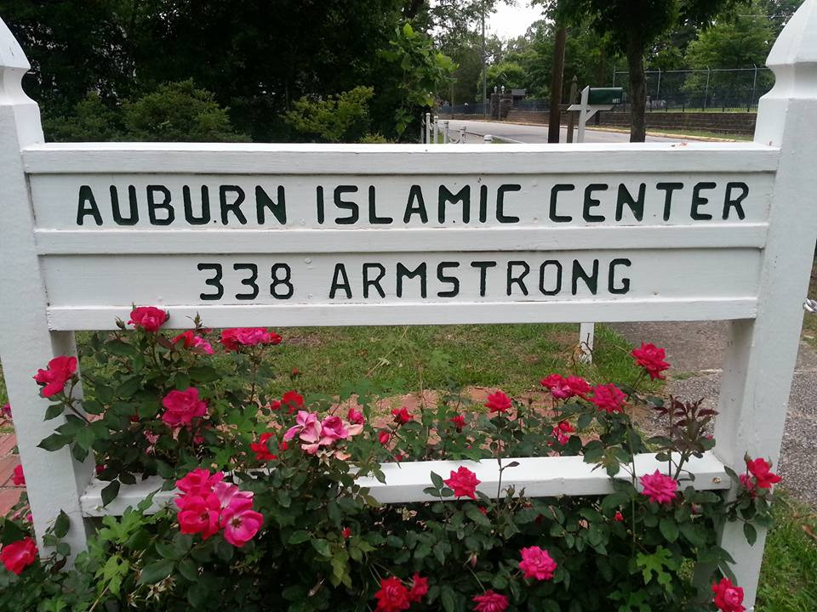
Auburn Islamic Center - Pavilion Slab
Client:
  Auburn Islamic Center
  Contacts:
    Dr. Mustafa Kazmi
    Dr. Afu Abdul
Group 3 Project Team:
  Trey Lowrey
  Connor Wilson
  Caleb Spearing
  Kyler Hancock
  Mace Keenum
  Matthew Barnett
  Michael Ritter
  Tanner Mayfield

Slide 2
Project Description
The Auburn Islamic Center has a wooden pavilion covering an area for recreation. This pavilion provides a spot for children to play or for adults to cookout and enjoy the outdoors.
This structure is supported by 6”x6” posts and has a metal roof. Currently, there is no floor system, making the area less desirable to use.

Slide 3
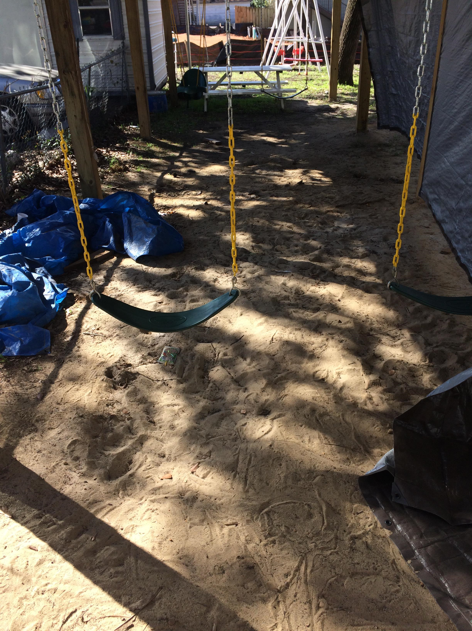
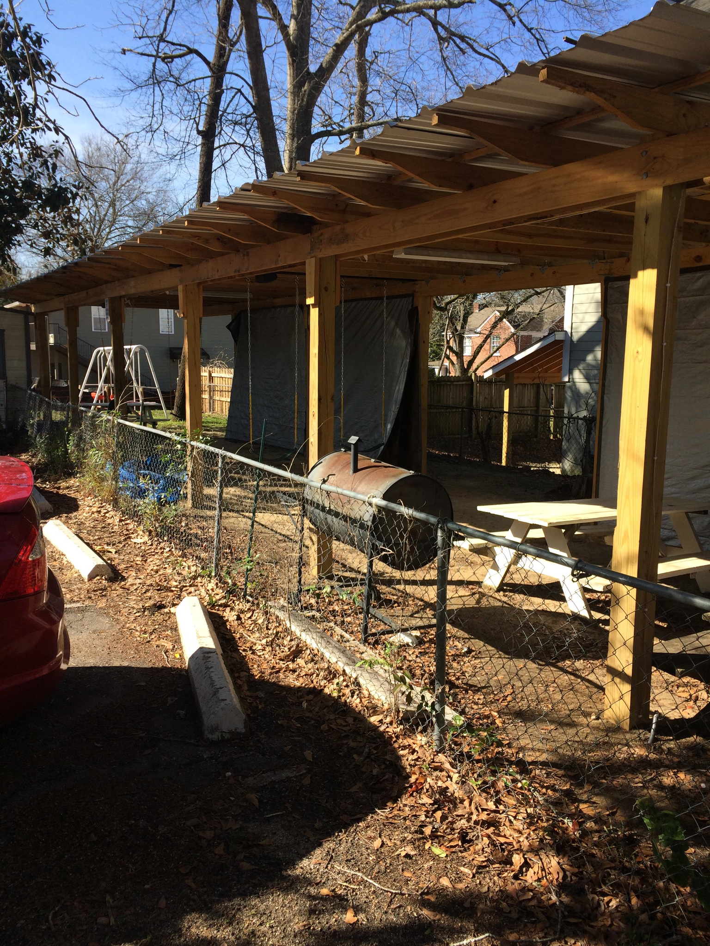
Project Description
As you can see, it would be very easy for children to get dirty in a play environment such as this.
The area is also not aesthetically pleasing with the current floor situation.

Slide 4
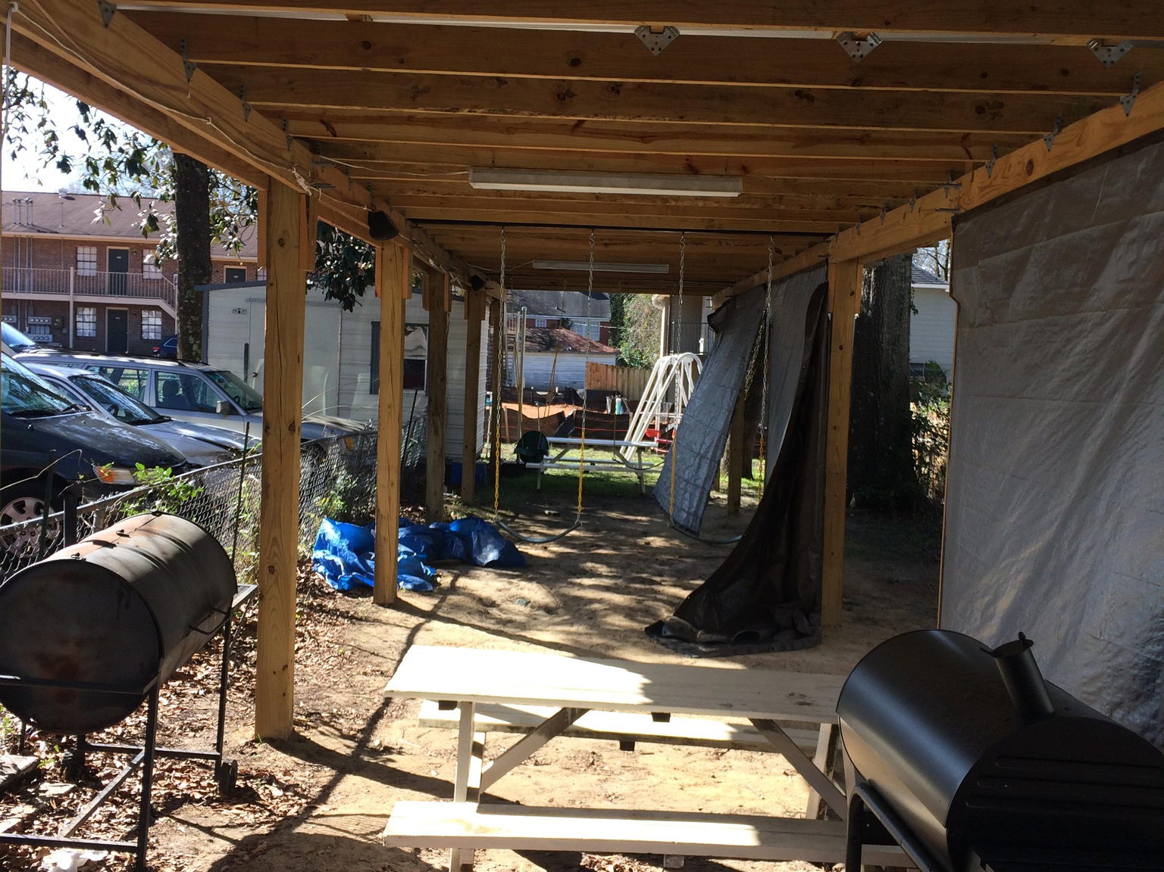
Project Description
Our group has been given the opportunity to design a concrete slab for this pavilion. The slab will cover everything underneath the structure and extend 1 foot beyond the perimeter. This will provide the users with a clean, durable surface to enjoy for years to come.

Slide 5
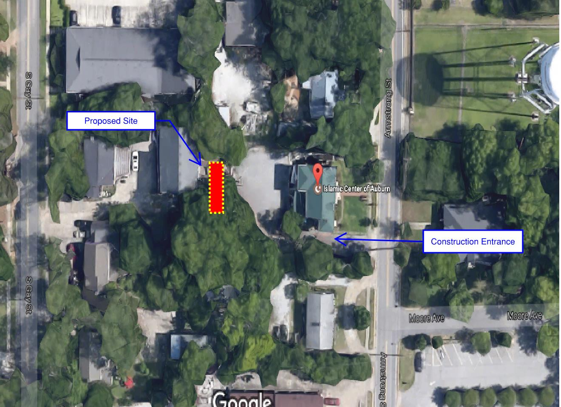
Site Location

Slide 6
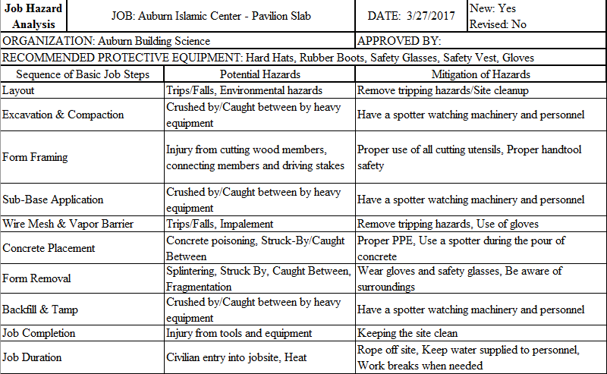
Job Hazard Analysis

Slide 7
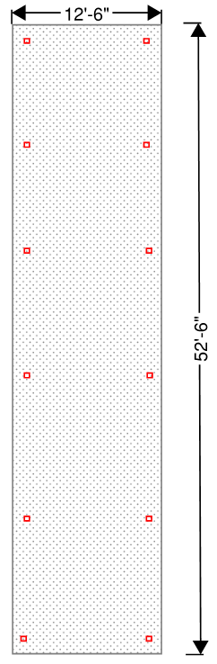
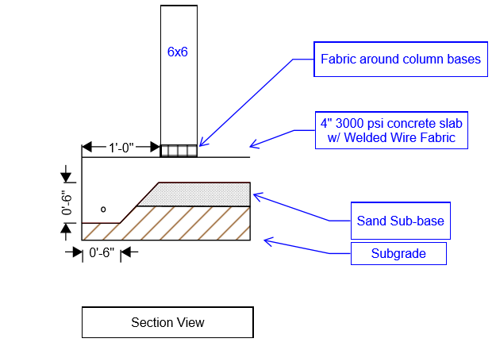
Section and Plan Views

Slide 8
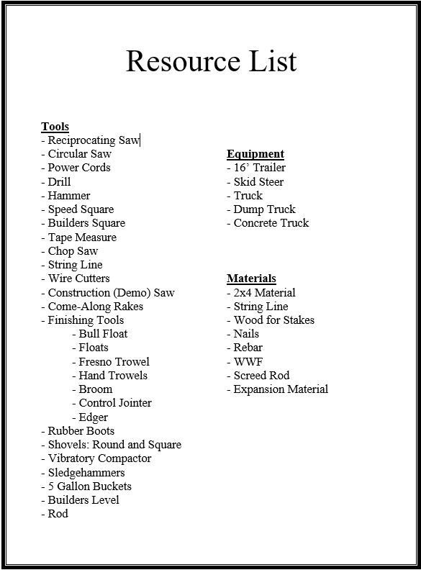

Slide 9
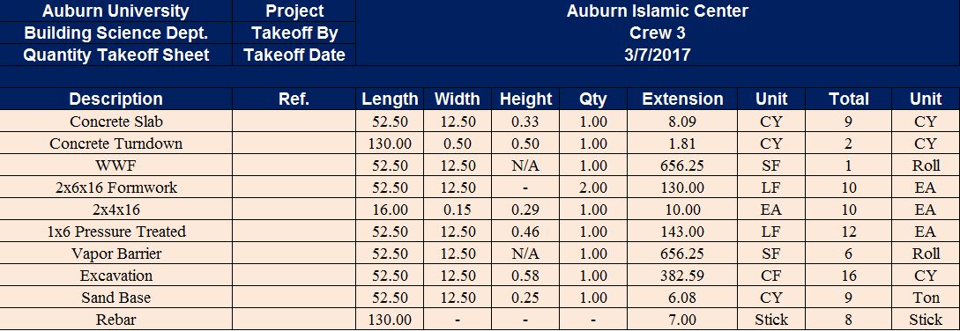
Quantity Takeoff

Slide 10
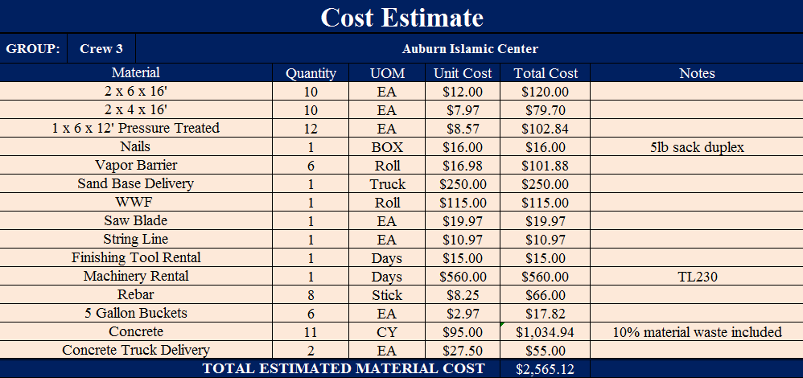
Cost Estimate

Slide 11
Concrete Mix Design
Concrete Mix Design – 3000 PSI
Materials | Amounts
Type I & II Cement | 375 lbs.
Fly Ash | 125 lbs.
Sand | 1325 lbs.
Limestone #57 | 1900 lbs.
Water Reducer | 1.64 lbs.
Water | 275.2 lbs or 33 gal.
W/CM | 0.55

Slide 12
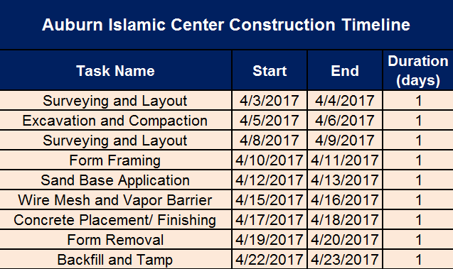
Proposed Schedule

Slide 13
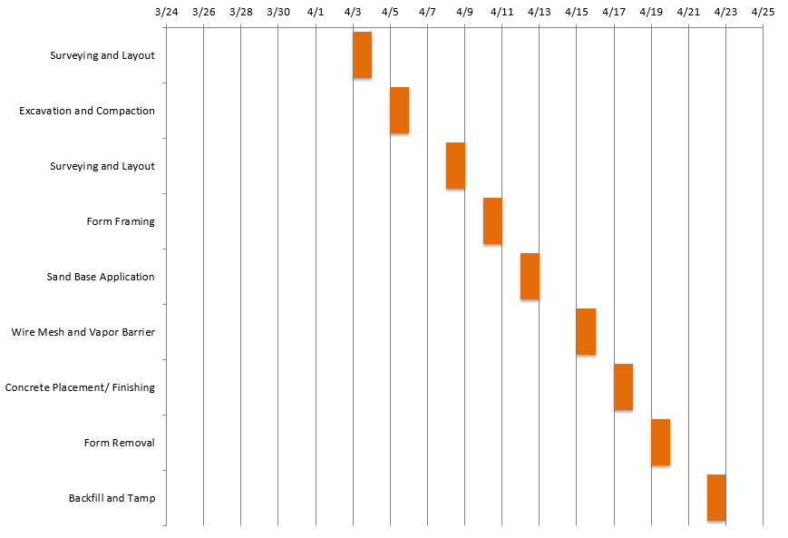
Proposed Schedule

Slide 14
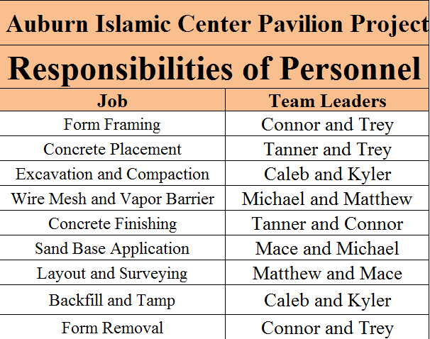
Personnel Responsibilities

Slide 15
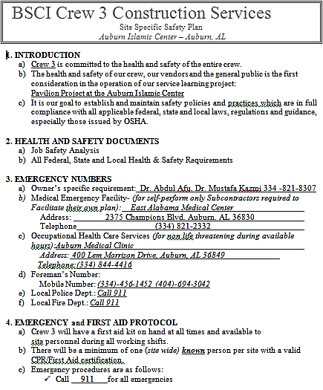
Safety Plan

Slide 16
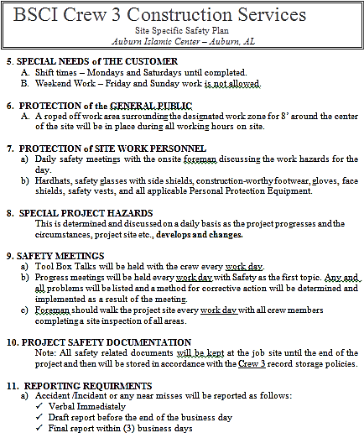

Slide 17
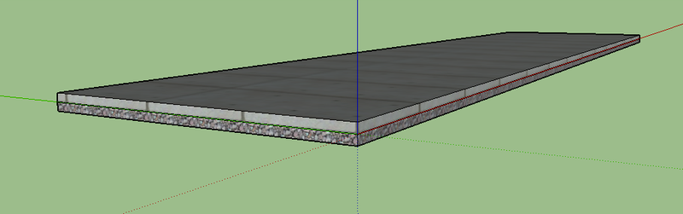
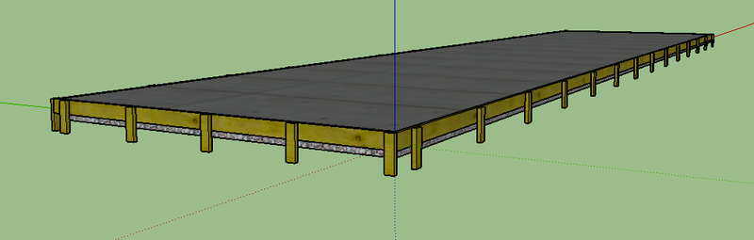
Project Model

Slide 18
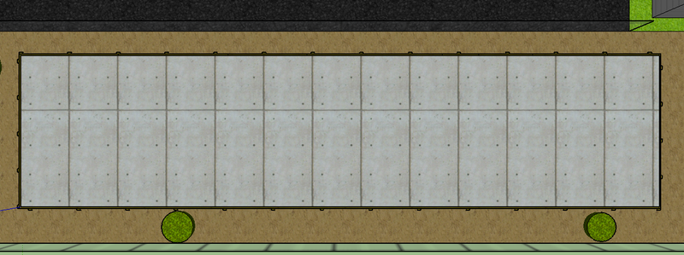
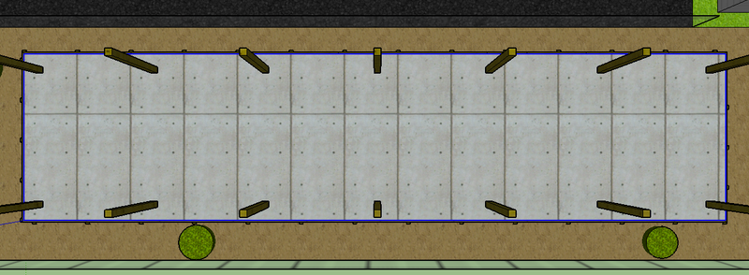

Slide 19
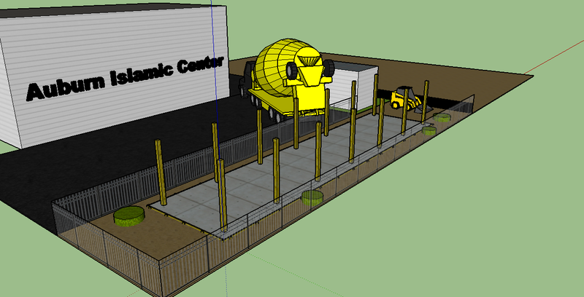
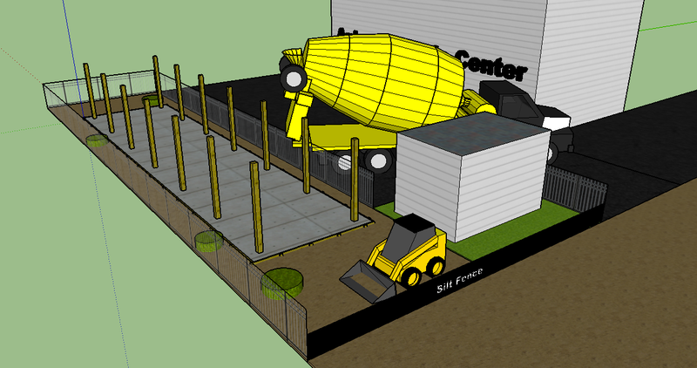

Slide 20
Proposal Agreement
I, _______________(print name), on behalf of the Auburn Islamic Center, agree to the previously proposed project conditions.
Signed:
________________
________________

